Slide 1

Mapping the Leaf: From Chá to Tea
How ancient trade routes shaped how we say “tea”
Claire Hattaway ∥ och240
NYU CS-GY 6313 Information Visualization
EXAMPLE.COM

Slide 2
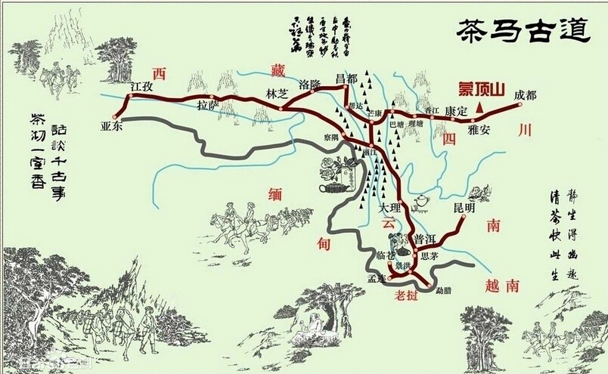
Problem and Motivation
Mapping the Leaf
Most languages around the world come from only two variations of the word “tea”.
Min Nan Chinese: “te”
Sinitic Chinese: “cha”
Trade routes have influenced how “tea” is said globally.
Depending on origin of where a region got their tea, variation is determined.
No collated visualization of this phenomenon has been visualized to show trade routes or linguistic word forms
EXAMPLE.COM

Slide 3
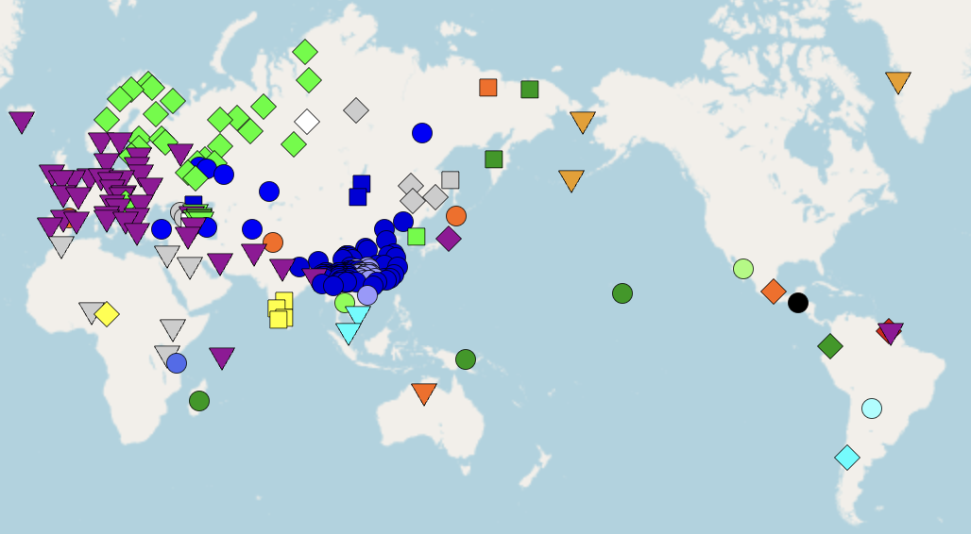
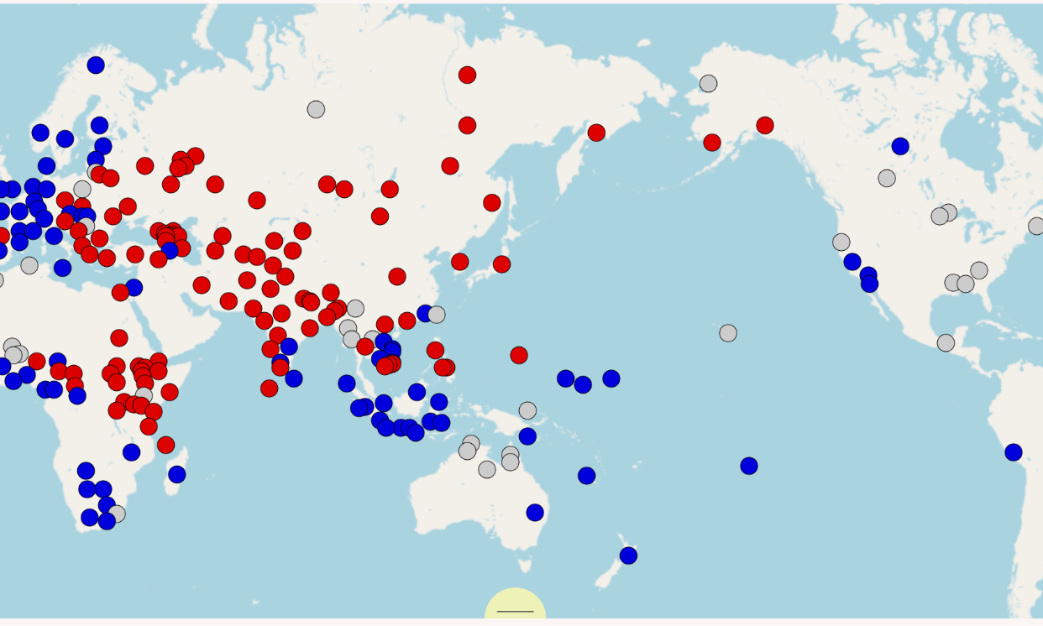
Datasets
WALS
Mapping the Leaf
Lexibank
An online compilation of linguistic studies to classify languages into “te” or “cha” derivations.
Compilation of linguistic studies to provide phonetic word forms and geospatial data of languages and their word form for tea.

Slide 4
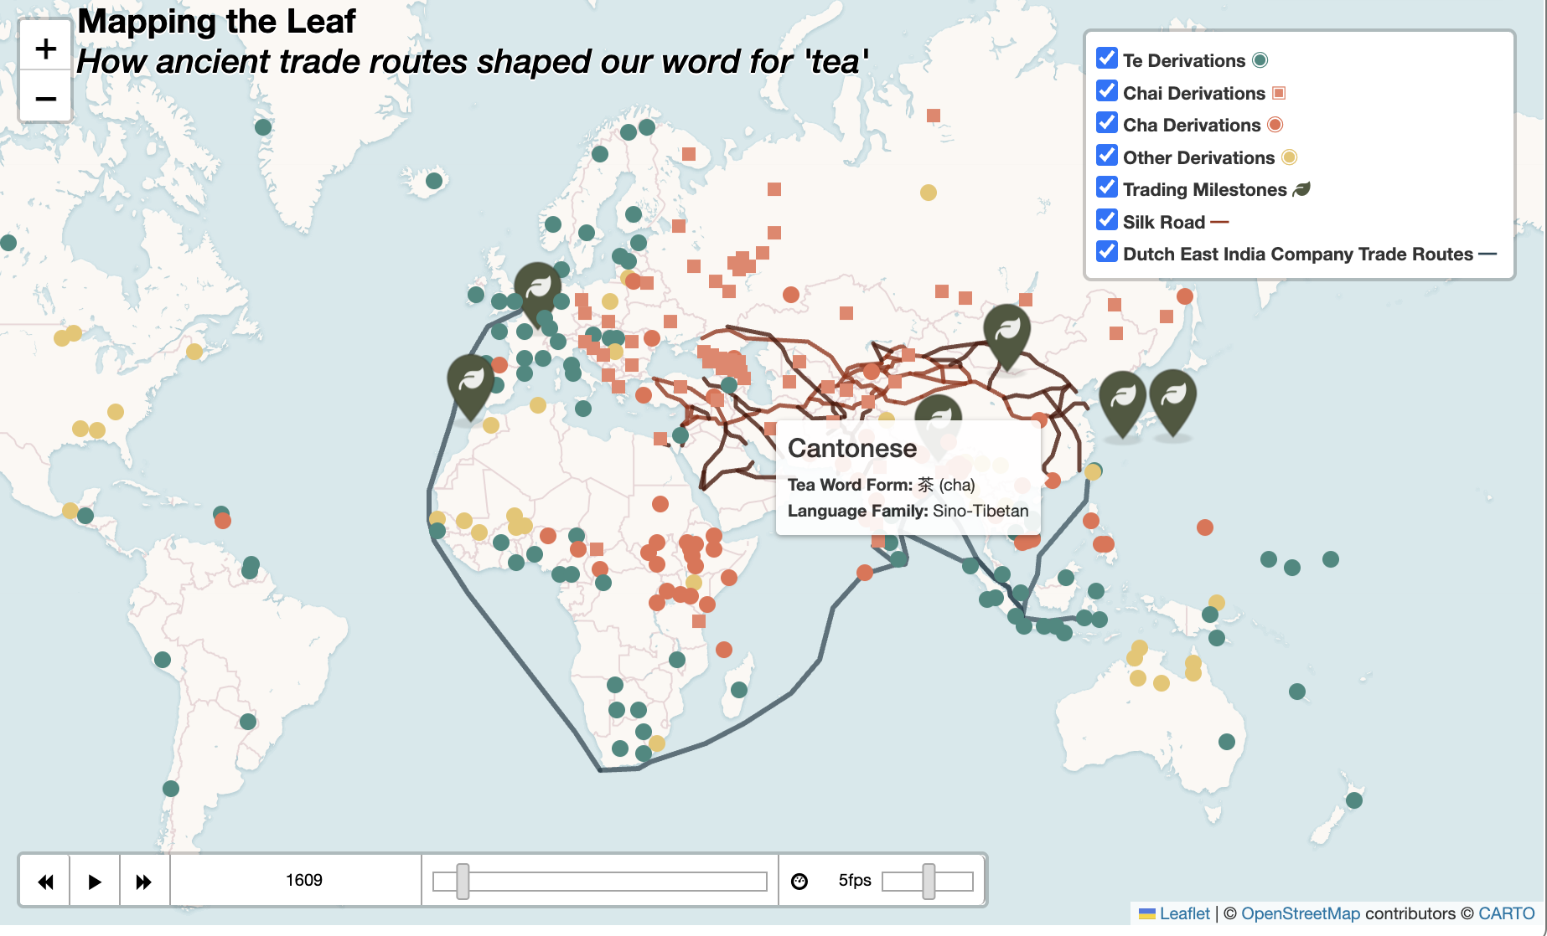
Visualization
Mapping the Leaf
An interactive and animated map to include word forms, historical milestones, and influential trade routes
Categorical encoding + time series animation

Slide 5
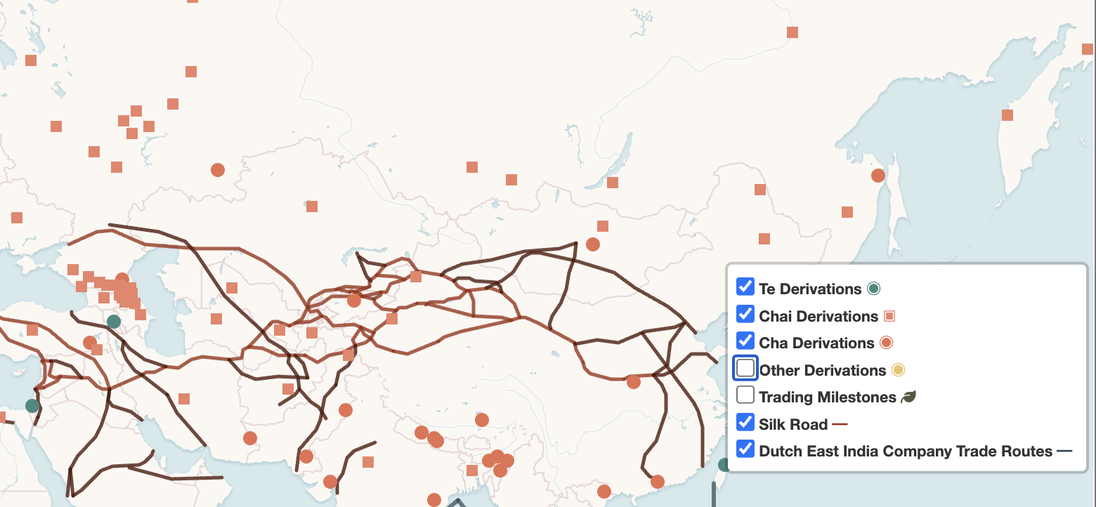
Insights
Mapping the Leaf
The visualization with trade routes provides a fairly confident view that most languages in Eurasia and South Asia were introduced to tea from the Silk Road, as well as several African countries on the West coast that are in close proximity to the Middle East. For Europe, the Southeast Asian Austronesian islands and the Eastern coast Africa, these cultures most likely were introduced to tea from the Dutch East India Trading Company.
With the added layer of linguistic word forms, there appear to be three subcategories- the known "chai" variation and two additional patterns that have yet to be explored (next slide). Though not definitive, “chai” variation may stem from Altai Mountain region with early civilizations establishing trade with China.

Slide 6
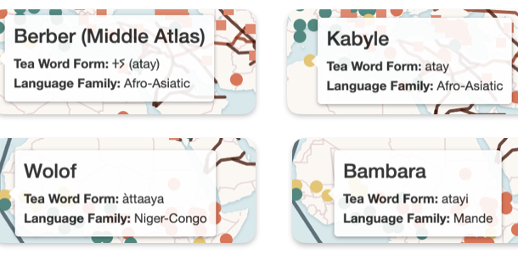
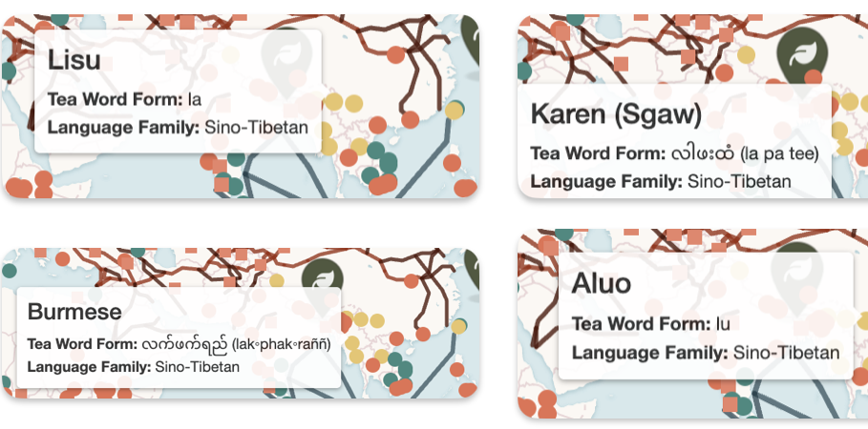
Contributions: New Patterns Discovered
PORTFOLIO
“la”/”lu” Pattern in Southeast Asia
Design Agency Name
“A(ti/tay)” Pattern in Northwest Africa
#
Rather than having a "ch" or "t" sound at the beginning of their word for tea, these languages have adopted an "l" sound.
May suggest that these languages may not have an equivalent of a "ch" sound and adopted a close approximation of a sound, perhaps uncovering an additional linguistic pattern.
Add a vowel before a variation of a "ti" or "tay" sound, such as "i" or "a".
Could potentially result in additional classifications of several African languages as deriving from "te" with additional phonetic research.

Slide 7

Mapping the Leaf
Demo Included Separately

